Slide 1

Navigator - Advanced Search
Joshua Rumley
Navigator and E-Advising Coordinator

Slide 2
Navigator Advanced Search

Slide 3
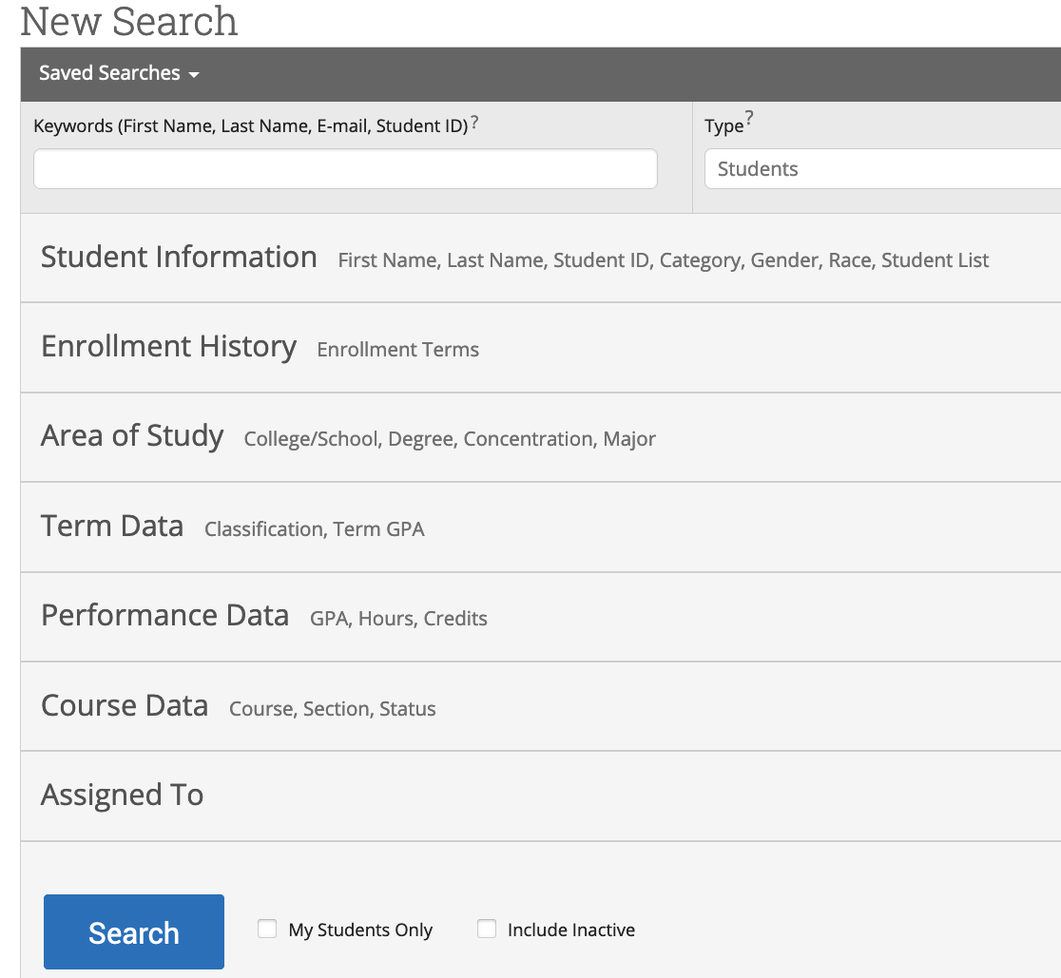
Advanced Search
Navigator query tool.
The search results are used as the foundation for building messages for students or tracking student progress.
Search pull lists of current students that fit the search parameters. Information in the results reflect current (matriculated) student data in Campus Solutions.
Students with unmet admission requirements will now show in Navigator until their status has changed.
While Advanced Search does not display historical data for students in the resulting list, you can create parameters based on historical conditions.

Slide 4
Advanced Search
Things you can do with search results:
  Tag students
  Schedule Appointments
  Export to Excel
  Create Student List
  Save Search Parameters
  Send Communication
  Import students into a new Appointment Campaign

Slide 5
Advanced Search
Advanced Search Logic
  Advanced Search uses different logic statements to build queries. Most search filters create AND statements. As you build a search, the query identifies students that satisfy all the listed requirements.
    Example:
      A search for Major: Biology AND
      Classification: Junior AND
      Missing Success Markers: 1-5
        Pulls a list of Junior biology majors with 1-5 missing success markers.

Slide 6
Advanced Search
Advanced Search Logic
  There are some filters that create OR statements. OR statements let you make multiple selections in a given field to increase the scope of your search. These search fields are indicated by the presence of an In Any of these identifier in the title.
  Filters that allow you to make OR statements include:
    Category
    Tag
    Enrollment
    Term
    College/School Major
    Classification

Slide 7
Advanced Search Filters – Student Information

Slide 8
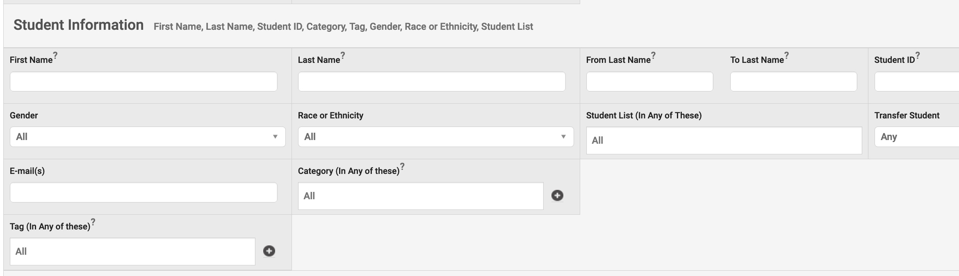
Student Information Filter

Slide 9
Student Information Filter
Apply Gender Filter
Female
Male
Apply Race or Ethnicity
Hispanic
Asian
NS (Not Selected)
Black
White
American Indian
Hawaiian
SWANA
Student List (In Any of These)
Users can import their student lists
Multiple lists can be imported

Slide 10
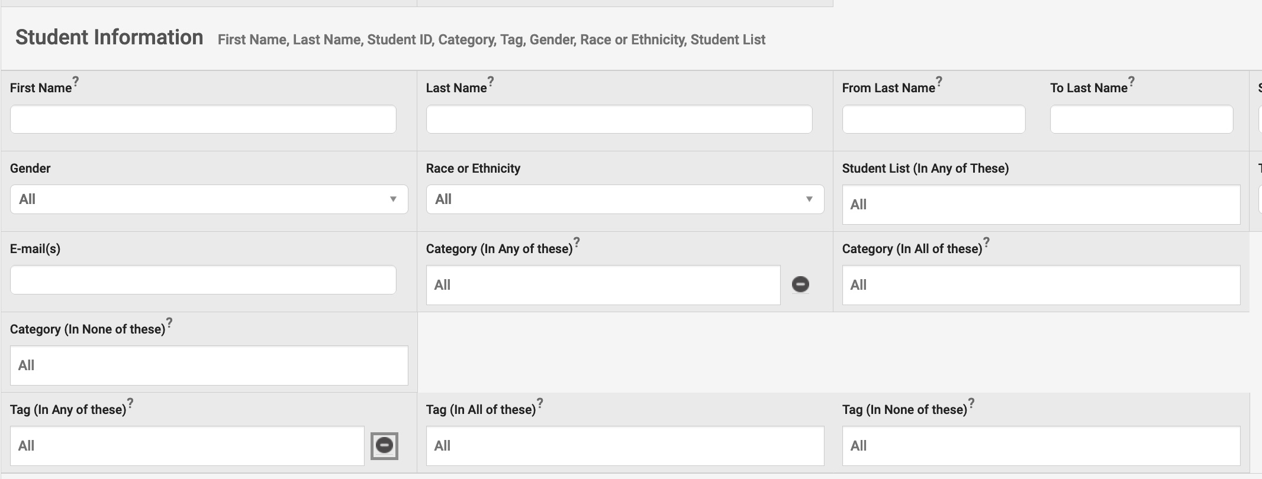
Student Information Filter
Expand filters for Category & Tag filters by clicking on the +

Slide 11
Student Information Filter
Data found in the Category filter
  Student Cohorts (Undergraduate & Graduate)
  Service Indicators
  Academic Minors
  Campus Program Cohorts
    EOP
    SOAR TRIO
    Metro
Category items are managed in CS by the Registrars office.
Category items are usually approved before they are imported into Navigator, but items do make it through occasionally without being approved.

Slide 12
Student Information Filter
Tags (Guide: https://sfsu.box.com/s/vxgjk4aot10o4u36zp2d3uv1d79suwis)
Created, added, and removed by any user
Visible across the platform
Visible to users who did not create the tag or add it to a student profile
Allows the user to track populations that are not automatically organized by a service indicator, cohort, or student category
Student Lists
Mostly static
Only visible to the user who created the list
Manually created and managed by individual user
Can pull tags into the Population Health Dashboard
Can pull student lists into the Population Health Dashboard

Slide 13
Student Information Filter
Tag Naming Convention [TERM][College Team][Tag Name][Initials of Tag Creator]
Tag Naming Convention Examples
FA22 UAC FTF ORI Jun10 (attended)_JR
FA22 UAC FTF Jun10 (not attend)_JR
FA22 EOP Nursing Interest_JR
FA22 COSE Nursing Interest_JR

Slide 14
Advanced Search Filters – Enrollment History

Slide 15
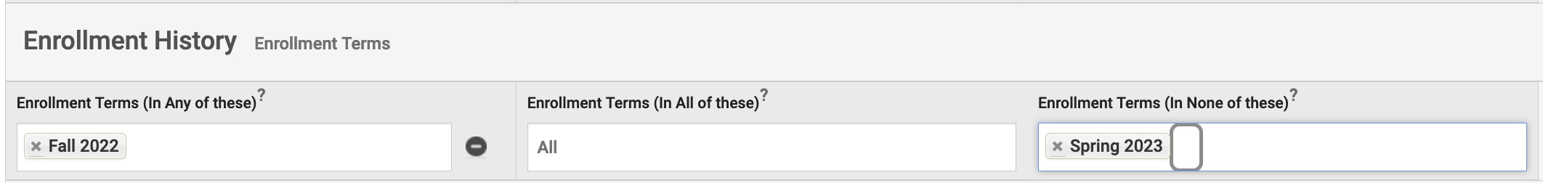
Enrollment History Filter
Expand filters for Enrollment Term filter by clicking on the +
Basic Search Example – Students enrolled in FA22, not enrolled SPR23

Slide 16
Enrollment History Filter
Enrollment data shows in Navigator the day after registration begins.
Updates in CS will show in Navigator after the nightly refresh.

Slide 17
Advanced Search Filters –
Area of Study

Slide 18
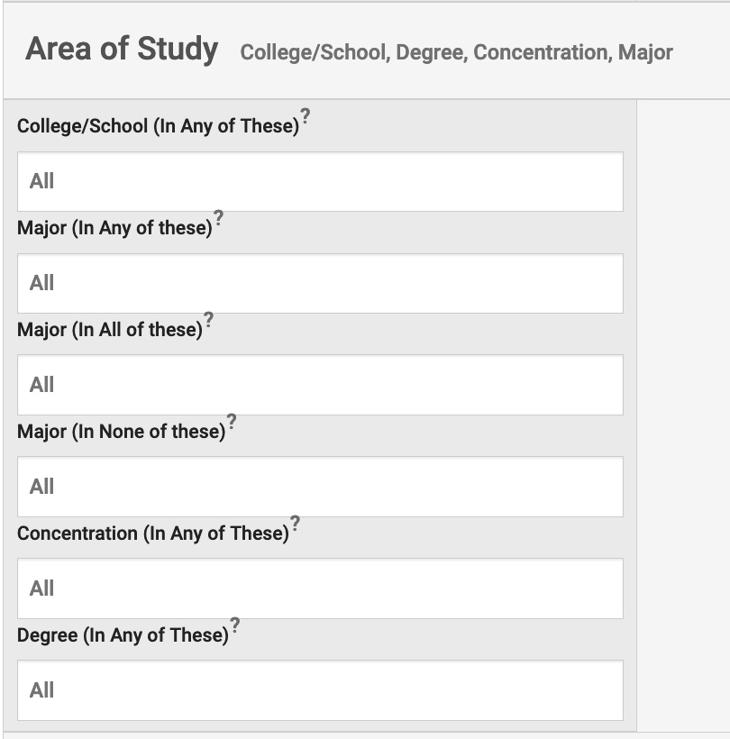
Area of Study Filter
College/School (In Any of These) can be used to pull all the students from a specific college.
Undergraduate and graduate programs can be searched.
Things to Note:
  Major table managed by Academic Planning.
  Undeclared-BS shows as a major, but we’re working to remove the classification.
  Pre-Nursing shows as a major because students were declared in major before the major was discontinued.

Slide 19
Advanced Search Filters
Term Data

Slide 20
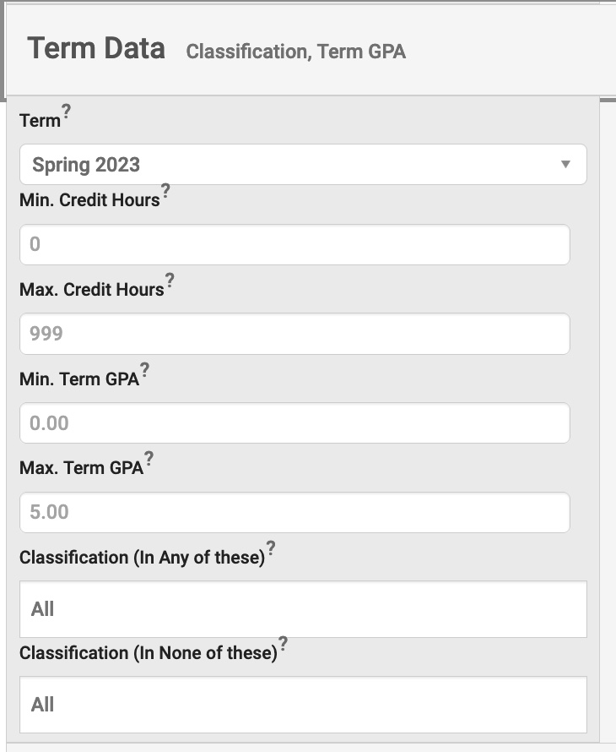
Term Data Filter
Term Data filter can be used to search for students within a specific credit range for a term of enrollment.
Classification filter can be used to search for a specific classification(s) of students.
  Freshman
  Sophomore
  Junior
  Senior
  Graduate
Classification filter contains extra classifications that are not used, and we’re working to remove them.
  Adult Education
  Continuing Education
  Skills
  Credit

Slide 21
Advanced Search Filters
Performance Data

Slide 22
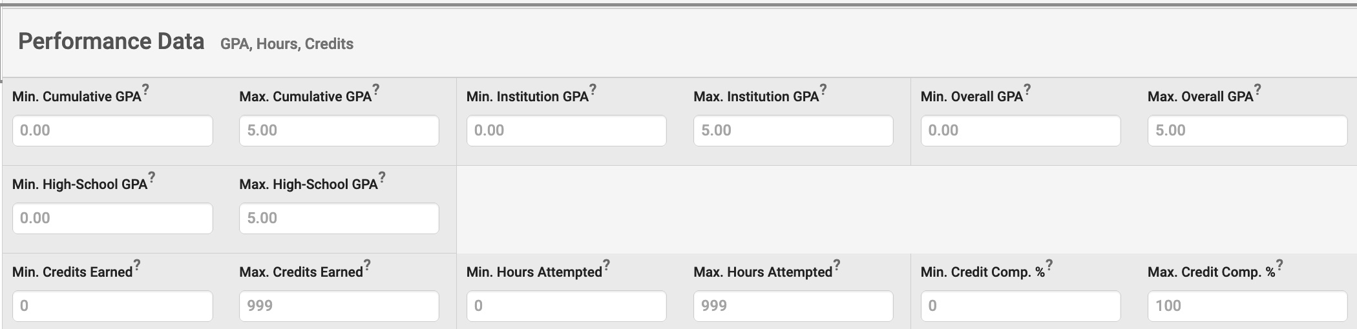
Performance Data Filter

Slide 23
Advanced Search Filters
Course Data

Slide 24
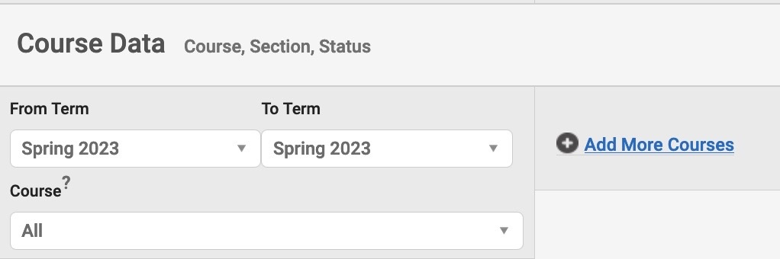
Course Data
Course Data filter can be used to search for:
  Course Enrollment for a term or range of time.
  Previous Course Attempt for a term or a range of time.
  Course repeat in current term.
  No Course enrollment for a term or a range of time.
+ Add More Courses allows users to search for additional courses.
  Add More Courses creates a relational AND search for the courses, and Navigator will search for both courses and conditions.

Slide 25
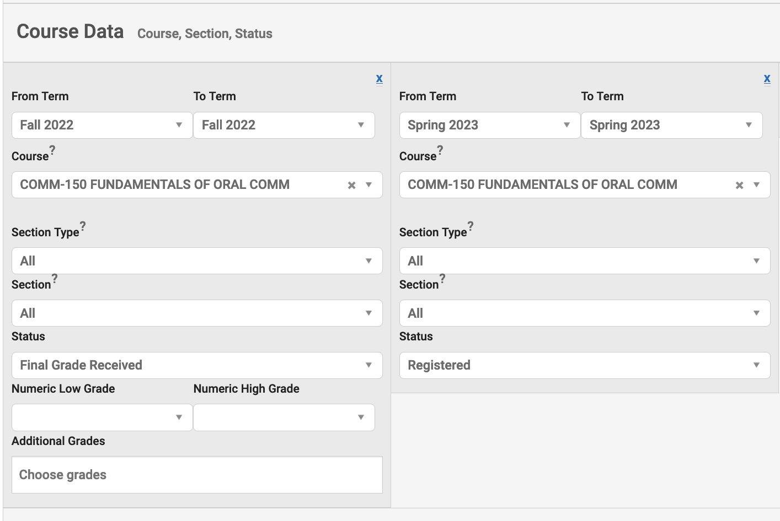
Course Data
1
2
Previous Course Attempt
  Term – Fall 2022
  Course – COMM-150
  Status – Final Grade Received
Current Term Enrollment
  Term – Spring 2023
  Course – COMM-150
  Status - Registered

Slide 26
Advanced Search Filters
Assigned To

Slide 27
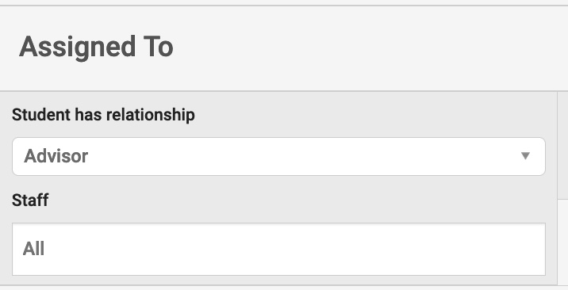
Assigned to Filter
Multiple staff can be added to the search.
Users can search for students with no advisor assignment by selecting “No Assigned Staff for this Relationship” option under Staff.

Slide 28
Advanced Search Filters
Success Indicators

Slide 29
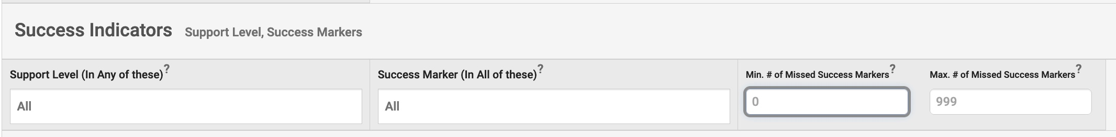
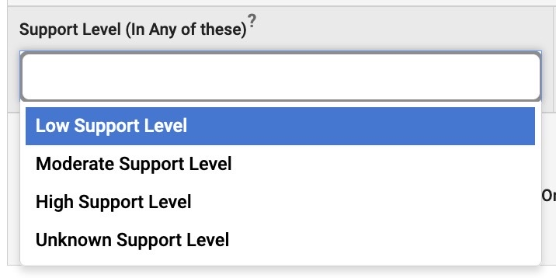
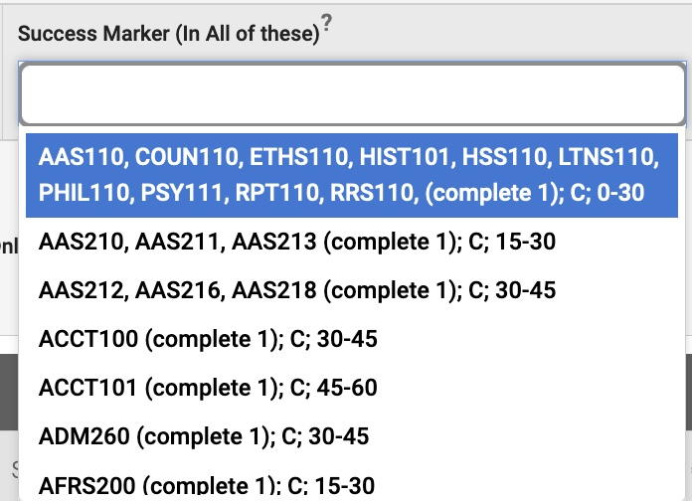
Success Indicators
It is recommended that users use the Min # of Missed Success Markers and Max # of Missed Success Markers filters to identify students with missed markers.
Unfortunately, the markers listed in the Success Markers (in All of These) do not have information to identify what major the maker is assigned to.

Slide 30
Advanced Search Actions -Student Lists

Slide 31
Advanced Search Actions - Student Lists
A Student List is a static list of students by student ID.
A list can be created by saving the results of an Advance Search.
A list can also be created by uploading a CSV file of student ID numbers.
A list can be updated, but a user must save search results to the list or upload another CSV file.

Slide 32
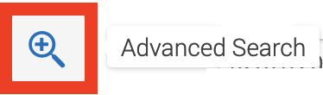
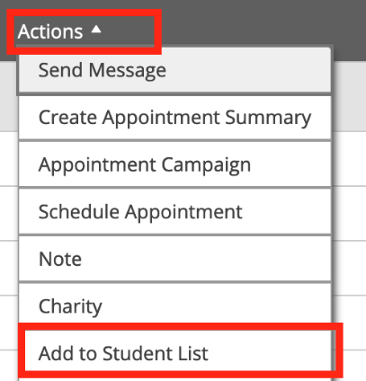
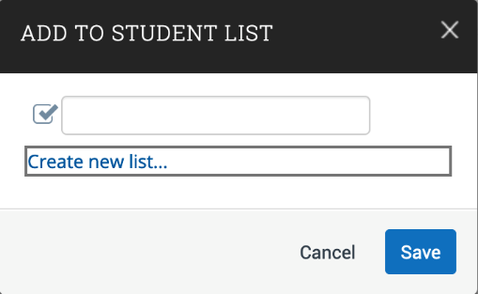
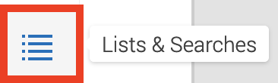
Advanced Search Actions - Student Lists
Step 1: Click on the Advance Search Icon.
Step 2: After searching for students, click to select all student records, and select ACTIONS to find Add to Student List.
Step 3: Create a new student list or add the results to an existing list. Save the list.
Step 4: To view the list, click on the Lists & Searches icon.

Slide 33
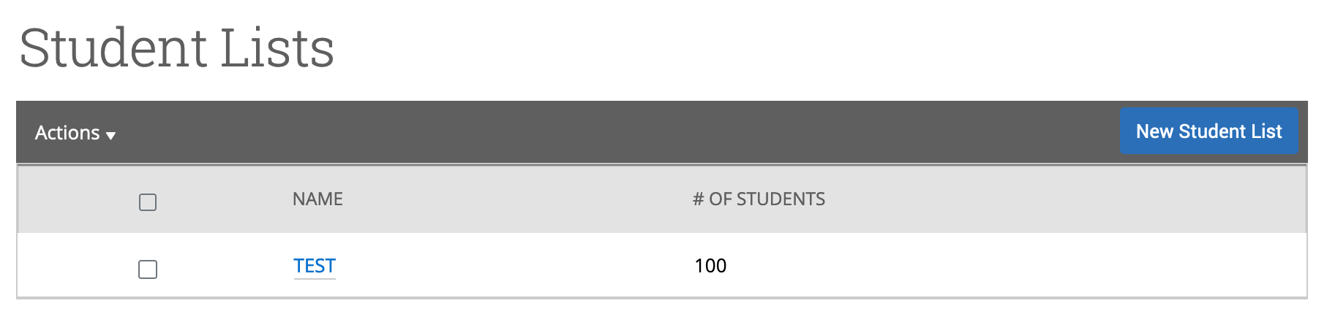
Advanced Search Actions - Student Lists
Step 5: Click on the list name to expand it and to review the list of students.

Slide 34
Advanced Search Actions- Communication

Slide 35
Advanced Search Actions- Communication
You can send emails to one or more students from Staff Home, the student profile, or Advanced Search.
Most Action menus throughout the platform also allow for sending emails.
The Conversations function allows users to view messages sent to students.
On student profile, under the Conversations tab, you have a historical view of messages sent to a student by other users.

Slide 36
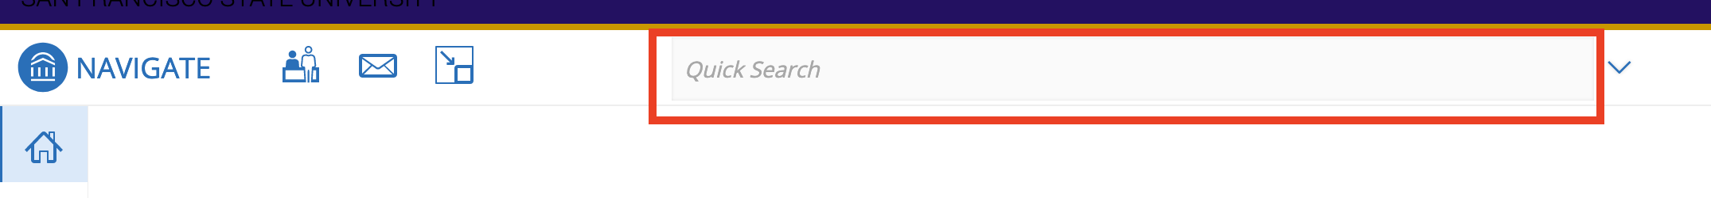
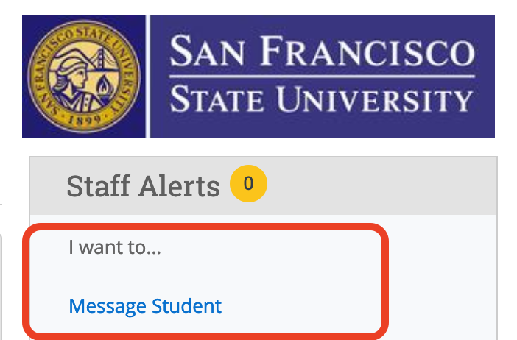
Advanced Search Actions- Communication
Step 1: Use Quick Search to navigate to a student profile. You may search by a student name or ID #.
Step 2: On student profile, under SF State logo, click Message Student.

Slide 37
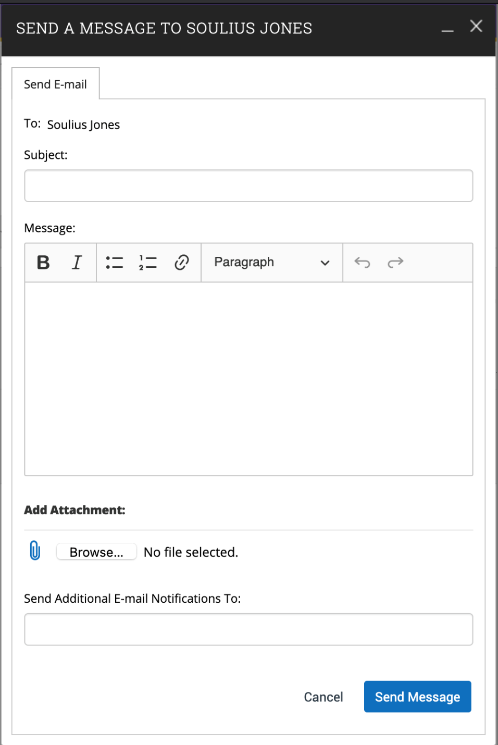
Advanced Search Actions- Communication
Step 3: On the message screen, you can set the email subject, compose a message, hyperlink relevant URLs in the body of the message, attach documents, and indicate to other individuals you want to receive a notification email.
Step 4: Click Send Message to send the message to the student.

Slide 38
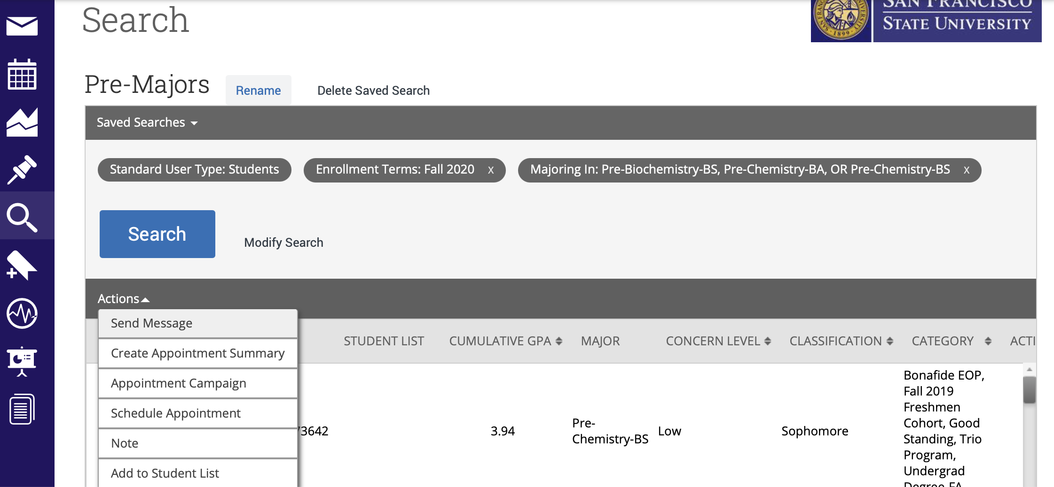
Advanced Search Actions- Communication

Slide 39
Questions
Have Questions? Need Support?
Joshua Michael Rumley
Navigator & E-Advising Coordinator
Email: JoshuaRumley@sfsu.edu
Support Website: https://navigator.sfsu.edu
Schedule Meeting/Training Session

